Slide 1
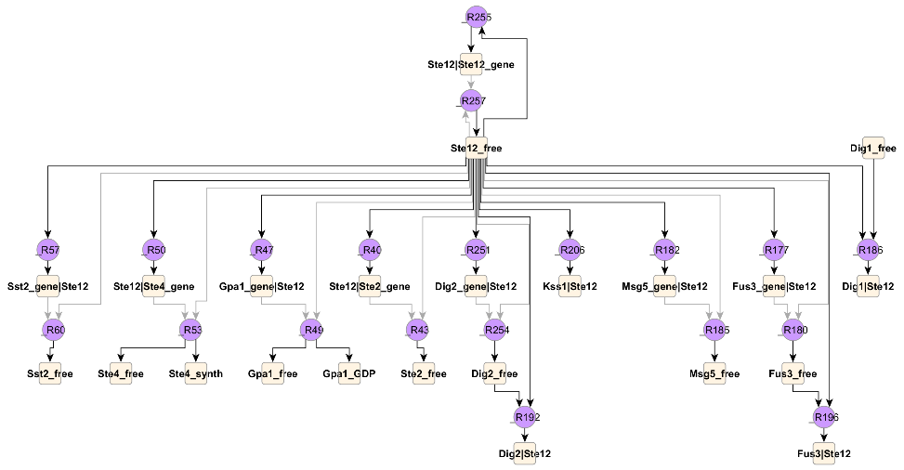

Overview of Rule-based modeling of cell signaling
JIM Faeder
Department of Computational and Systems Biology
University of Pittsburgh School of Medicine
MMBioS Cell Modeling Workshop
July 12, 2021

Slide 2
Toward an integrated model of the cell
How to accomplish the task of linking together signaling modules that determine cell fate?
^{Tyson and Novak,} ^{Annu. Rev. Phys. Chem. 61,} ^{219–40 (2010)}

Slide 3
Integrated Model of MCF10A Cell
Coded in Matlab
Bouhaddou et al. (2017) PLOS Computational Biology

Slide 4
Specification
Translating knowledge about intracellular biochemistry into executable models

Slide 5
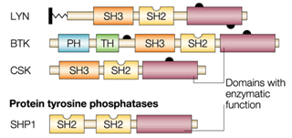
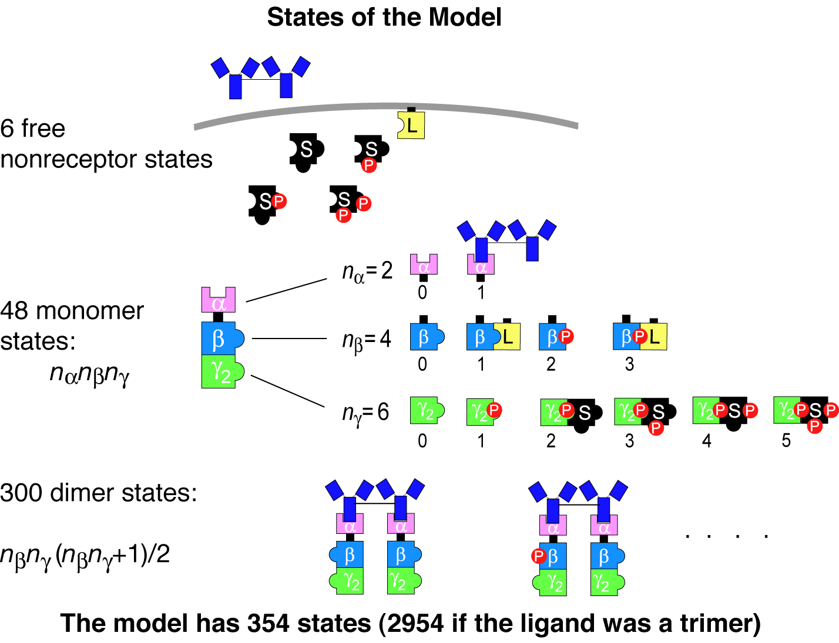
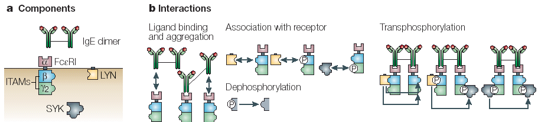
Challenges of modeling cell regulatory networks
Proteins are multi-functional
Representing their known interactions requires handling of combinatorial complexity
multiple sites of binding
multiple sites of posttranslational modification
Small number of rules
Small number of components and interactions ➔huge number of possible species and reactions

Slide 6
Combinatorial complexity in a realistic model of EGFR signaling
ErbB3:ErbB1 has > 3.8x10⁹ states
ErbB1:ErbB1 has > 5.5x10¹⁰ states
Such models can be built from a manageable number of rules – 10’s to 100’s
Creamer et al. (2012) BMC Syst. Biol.

Slide 7
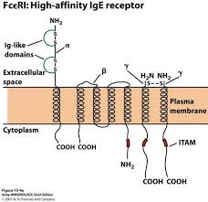
What is Rule-based Modeling (RBM)?
Molecules are modeled as structured objects
LYN(SH3,SH2,kin,Y397~0~P,Y508~0~P)
Molecule
States
Components
FceRI(a_Ig,b_Y218~0~P,g_ITAM~0~P)

Slide 8
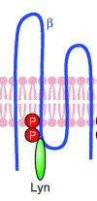
What is Rule-based Modeling (RBM)?
Rules define the interactions of molecules
“Lyn SH2 domain binds to phosphorylated Tyr 218 on the β subunit of FcεRI ”
Reactants
Products
Rate Law
Rule:
LYN(SH2) + FceRI(bY_218~P) <-> LYN(SH2!1).FceRI(bY_218~P!1) kpL, kmL
bond
“Don’t write don’t care” – elements not mentioned may be in any state
➔ One rule can generate reactions involving many different species
Reaction rate determined by Mass Action kinetics
rate forward = kpL*[Lyn(SH2)]*[FceRI(bY_218~P)]

Slide 9
Composition of a Rule-Based Model
Molecules (4)
Reaction Rules (19)
BioNetGen language
begin molecule types
Lig(l,l)
Lyn(U,SH2)
Syk(tSH2,l~U~P,a~U~P)
Rec(a,b~U~P,g~U~P)
end molecule types
begin reaction_rules
# Ligand-receptor binding
1 Rec(a) + Lig(l,l) <-> Rec(a!1).Lig(l!1,l) kp1, km1
Rec(a) + Lig(l,l) <-> Rec(a!1).Lig(l!1,l) kp1, km1
# Receptor-aggregation
2 Rec(a) + Lig(l,l!1) <-> Rec(a!2).Lig(l!2,l!1) kp2,km2
# Constitutive Lyn-receptor binding
3 Rec(b~Y) + Lyn(U,SH2) <-> Rec(b~Y!1).Lyn(U!1,SH2) kpL, kmL
…

Slide 10
Composition of a Rule-Based Model
Molecule types (4)
Reaction Rules (19)
Network Generation
Species (354)
Reactions(3680)
1 Lig(l,l) Lig_tot
2 Lyn(SH2,U) Lyn_tot
3 Syk(a~Y,l~Y,tSH2) Syk_tot
4 Rec(a,b~Y,g~Y) Rec_tot
5 Lig(l!1,l).Rec(a!1,b~Y,g~Y) 0
6 Lyn(SH2,U!1).Rec(a,b~Y!1,g~Y) 0
7 Lig(l!1,l).Lyn(SH2,U!2).Rec(a!1,b~Y!2,g~Y) 0
8 Lig(l!1,l!2).Rec(a!2,b~Y,g~Y).Rec(a!1,b~Y,g~Y) 0
9 Lig(l!1,l!2).Lyn(SH2,U!3).Rec(a!2,b~Y!3,g~Y).Rec(a!1,b~Y,g~Y) 0
…
1 Rec(a,b~Y,g~Y) + Lig(l,l) -> Lig(l!1,l).Rec(a!1,b~Y,g~Y) 2*kp1
2 Rec(a,b~Y,g~Y) + Lyn(SH2,U) -> Lyn(SH2,U!1).Rec(a,b~Y!1,g~Y) kpL
3 Lyn(SH2,U!1).Rec(a,b~Y!1,g~Y) + Lig(l,l) -> Lig(l!1,l).Lyn(SH2,U!2).Rec(a!1,b~Y!2,g~Y) 2*kp1
4 Lig(l!1,l).Rec(a!1,b~Y,g~Y) -> Rec(a,b~Y,g~Y) + Lig(l,l) km1
5 Rec(a,b~Y,g~Y) + Lig(l!1,l).Rec(a!1,b~Y,g~Y) -> Lig(l!1,l!2).Rec(a!2,b~Y,g~Y).Rec(a!1,b~Y,g~Y) kp2
6 Lyn(SH2,U!1).Rec(a,b~Y!1,g~Y) + Lig(l!1,l).Rec(a!1,b~Y,g~Y) -> Lig(l!1,l!2).Lyn(SH2,U!3).Rec(a!2,b~Y!3,g~Y).Rec(a!1,b~Y,g~Y) kp2 7 Lig(l!1,l).Rec(a!1,b~Y,g~Y) + Lyn(SH2,U) -> Lig(l!1,l).Lyn(SH2,U!2).Rec(a!1,b~Y!2,g~Y) kpL
8 Lyn(SH2,U!1).Rec(a,b~Y!1,g~Y) -> Rec(a,b~Y,g~Y) + Lyn(SH2,U) kmL
9 Lig(l!1,l).Lyn(SH2,U!2).Rec(a!1,b~Y!2,g~Y) -> Lyn(SH2,U!1).Rec(a,b~Y!1,g~Y) + Lig(l,l) km1
…

Slide 11
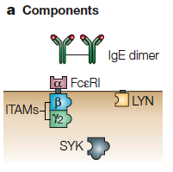
Defining Molecules
Molecules are the basic objects in a BNG model
BioNetGen Language
IgE(a,a)
FceRI(a,b~U~P,g2~U~P)
Lyn(U,SH2)
Syk(tSH2,lY~U~P,aY~U~P)
Components represent molecule elements
Domains
Motifs
Properties
Notes:
Start here – more or less.

Slide 12
Defining Molecules
Molecules are the basic objects in a BNG model
BioNetGen Language
IgE(a,a)
FceRI(a,b~U~P,g2~U~P)
Lyn(U,SH2)
Syk(tSH2,lY~U~P,aY~U~P)
Components may have different states representing
posttranslational modifications
conformational state
…
Notes:
Start here – more or less.

Slide 13
Binding
Molecules bind other molecules through components
BioNetGen Language
IgE(a,a!1).FceRI(a!1,b~U,g2~U)
Bonds are formed by linking two components. The ‘.’ indicates a set of molecules forming a complex.
Components may have both states and bonds.
Bonds may occur within a molecule.
FceRI(a,b~U!1,g2~U).Lyn(U!1)
Lyn(SH2!1,Cterm~P!1)
Notes:
Start here – more or less.

Slide 14
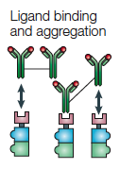
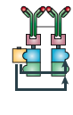
Defining Interaction Rules
BioNetGen Language
IgE(a,a)+ FceRI(a)<-> IgE(a,a!1).FceRI(a!1)
…
binding and dissociation
Transphosphorylation
Lyn(U!1).FceRI(b!1).FceRI(b~U)-> \
Lyn(U!1).FceRI(b!1).FceRI(b~P)
component state change

Slide 15
Parts of a rule
Reactants
Arrow
Products
Rate Law
IgE(a,a)+ FceRI(a)<-> IgE(a,a!1).FceRI(a!1) kp1, km1

Slide 16
Parts of a rule
Reactants
Arrow
Products
Rate Law
IgE(a,a)+ FceRI(a)<-> IgE(a,a!1).FceRI(a!1) kp1, km1
IgE(a,a)
FceRI(a,b~U,g~U)
Patterns select properties of each reactant molecule.

Slide 17
Parts of a rule
Reactants
Arrow
Products
Rate Law
IgE(a,a)+ FceRI(a)<-> IgE(a,a!1).FceRI(a!1) kp1, km1
IgE(a,a)
FceRI(a,b~U,g~U)
States of components not specified don’t affect the match.
“Don’t write, don’t care.”
FceRI(a,b~P,g~U)
Patterns select properties of each reactant molecule.

Slide 18
Parts of a rule
Reactants
Arrow
Products
Rate Law
IgE(a,a)+ FceRI(a)<-> IgE(a,a!1).FceRI(a!1) kp1, km1
IgE(a,a)+ FceRI(a,b~U,g~U)<-> IgE(a,a!1).FceRI(a!1,b~U,g~U) kp1, km1
IgE(a,a)+ FceRI(a,b~P,g~U)<-> IgE(a,a!1).FceRI(a!1,b~P,g~U) kp1, km1
Patterns select properties of each reactant molecule.
Because patterns can match many different species, each rule can generate many reactions.

Slide 19
Center and context
The center of a rule is the part that the rule changes.
bond is formed
IgE(a,a)+ FceRI(a)<-> IgE(a,a!1).FceRI(a!1) kp1, km1
The context is the part that is necessary for the rule to happen but is unchanged.

Slide 20
Center and context
The center of a rule is the part that the rule changes.
bond is formed
IgE(a,a)+ FceRI(a)<-> IgE(a,a!1).FceRI(a!1) kp1, km1
The context is the part that is necessary for the rule to happen but is unchanged.
Transphosphorylation
Context can represent complex biochemistry.
component state is changed
Lyn(U!1).FceRI(b!1).FceRI(b~U)-> \
Lyn(U!1).FceRI(b!1).FceRI(b~P)

Slide 21
Rule-based modeling enables knowledge representation on a large scale
FcεRI model
Precise encoding of modeled structures and interactions
User avoids combinatorial complexity
Amenable to visualization
Extensible as knowledge base grows
Faeder et al., J. Immunol. (2003)
Chylek et al., Mol. BioSys. (2011)

Slide 22
Rule-based modeling enables knowledge representation on a large scale
FcεRI model
T cell receptor model
20 molecule types
129 rules
Number of species is too large for network generation!
Faeder et al., J. Immunol. (2003)
Chylek et al., PLOS One (2014)

Slide 23
Simulation
Scalable simulation of rule-based models

Slide 24
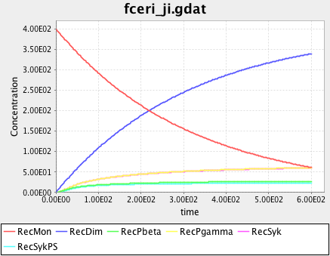
Methods for simulating RBMs
Model Specification
Indirect
Network Generation
1 Rec(a,b~Y,g~Y) + Lig(l,l) -> Lig(l!1,l).Rec(a!1,b~Y,g~Y) 2*kp1
2 Rec(a,b~Y,g~Y) + Lyn(SH2,U) -> Lyn(SH2,U!1).Rec(a,b~Y!1,g~Y) kpL
3 Lyn(SH2,U!1).Rec(a,b~Y!1,g~Y) + Lig(l,l) -> Lig(l!1,l).Lyn(SH2,U!2).Rec(a!1,b~Y!2,g~Y) 2*kp1
4 Lig(l!1,l).Rec(a!1,b~Y,g~Y) -> Rec(a,b~Y,g~Y) + Lig(l,l) km1
5 Rec(a,b~Y,g~Y) + Lig(l!1,l).Rec(a!1,b~Y,g~Y) -> Lig(l!1,l!2).Rec(a!2,b~Y,g~Y).Rec(a!1,b~Y,g~Y) kp2
6 Lyn(SH2,U!1).Rec(a,b~Y!1,g~Y) + Lig(l!1,l).Rec(a!1,b~Y,g~Y) -> Lig(l!1,l!2).Lyn(SH2,U!3).Rec(a!2,b~Y!3,g~Y).Rec(a!1,b~Y,g~Y) kp2 7 Lig(l!1,l).Rec(a!1,b~Y,g~Y) + Lyn(SH2,U) -> Lig(l!1,l).Lyn(SH2,U!2).Rec(a!1,b~Y!2,g~Y) kpL
8 Lyn(SH2,U!1).Rec(a,b~Y!1,g~Y) -> Rec(a,b~Y,g~Y) + Lyn(SH2,U) kmL
9 Lig(l!1,l).Lyn(SH2,U!2).Rec(a!1,b~Y!2,g~Y) -> Lyn(SH2,U!1).Rec(a,b~Y!1,g~Y) + Lig(l,l) km1
…
Reaction Network
Reaction Network Simulator
ODE’s, SSA

Slide 25
Combinatorial Complexity
5 proteins, 20 interactions 170,000 species

Slide 26
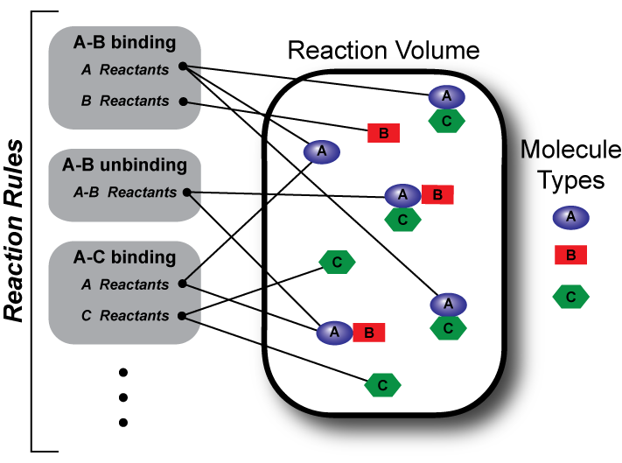
Methods for simulating RBMs
Model Specification
Indirect
Direct
Network Generation
Configuration Generation
Bypasses network generation
Reaction Network
Reaction Network Simulator
NFsim

Slide 27
Indirect Methods – Network Generation
a b c
A
B
C
contact map
reaction rules
species
a
+
A
a
A
4 molecule types
3 rules
11 species
12 reactions
b
+
B
b
B
c
+
C
c
C
reactions

Slide 28
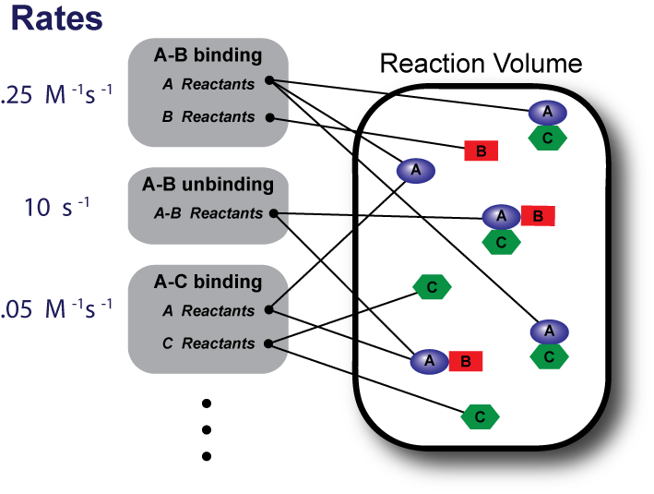
NFsim Algorithm
0. Initialize reactant lists and calculate rule propensities.
Select next reaction time and next rule.
Select molecules and sites to react.
Check any application condition(s).
Apply operation specified by rule.
Update reactant lists and propensities.
Increment time.
25 s⁻¹
10 s⁻¹
0.1 s⁻¹
Sneddon, Faeder, and Emonet (2011) Nature Methods

Slide 29
Direct Methods (NFsim)
reaction rules
event generation
a
+
A
a
a
+
A
a
A
a
A
6
4
6
a b c
A
A
B
C
a b c
B
B
C
b
+
B
b
B
a b c
a b c
B
A
C
a b c
B
6
5
B
C
6
C
B
a b c
a b c
A
A
a b c
c
+
C
c
a b c
C
C
A
B
A
a b c
A
B
C
7
3
5
a b c
C
B
a b c
A
B
A
system configuration
total propensity

Slide 30
FcεRI signaling models
NFsim can simulate models of greatly increased complexity with manageable increase in cost.
Increasing complexity
MW Sneddon, JRF, and T. Emonet (2011) Nat. Methods, 8, 177
Notes:
Would be great to have a screenshot of John’s small multiples for the FceRI models used here.

Slide 31
Other examples of network-free applications
Phosphoproteome dynamics
Multivalent aggregation in signaling
Holoenzyme dynamics
Chylek et al. (2014) PLOS One
Nag et al. (2009) Biophys. J
Kaya, Grundy et al., in progress.

Slide 32
BioNetGen and associated modeling tools
Harris, Hogg, et al. (2016) Bioinformatics, 32 (21): 3366-3368.

Slide 33
Why use RBM?
Concise and precise representation of biochemical knowledge
rules are simple (less context) when interactions are modular
Flexible with respect to simulation method
Deterministic / stochastic
Well-mixed / compartmental / spatial
Structures and rules are reusable
Rule libraries
Compact visual representation
Contact map and beyond
Contact map

Slide 34
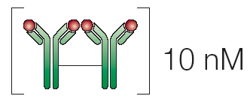
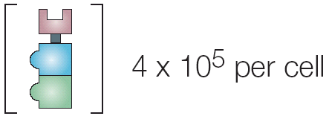
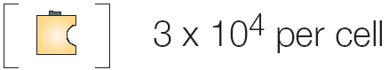
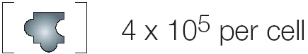
Rule-Based Modeling protocol
1. Identify components and interactions
2. Translate into objects (molecules) and rules
…
…
3. Determine concentrations and rate constants
4. Simulate and analyze the model
ODE’s
SSA
PDE’s
BD

Slide 35
Some Rule-Based Modeling Tools
BioNetGen & relatives
RuleBender
NFsim
BioNetGen@VirtualCell
Kappa & relatives
Simmune
pySB
ML-Rules
Smoldyn
SBML Level 3 Multi

Slide 36
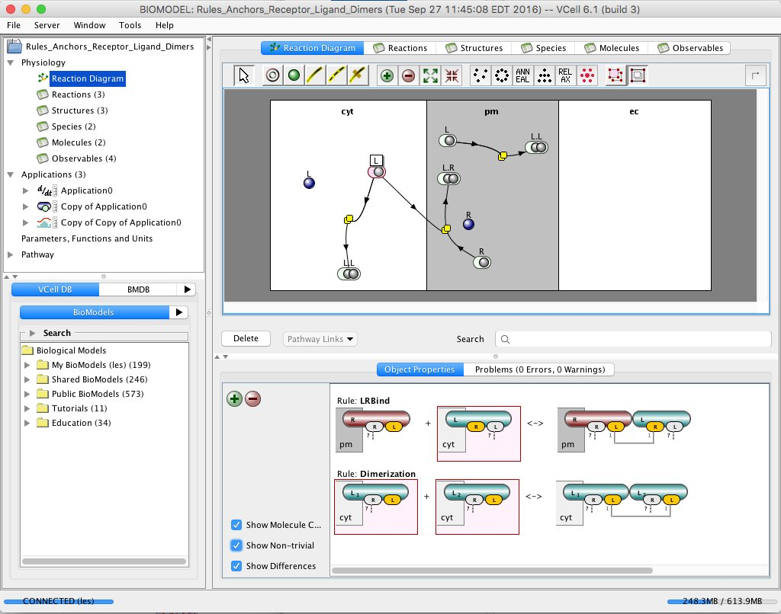
Software tools that integrate BioNetGen/NFsim
PySB - INDRA
BioNetFit
SBML Multi
Virtual Cell
Smoldyn
SRsim
BioUML
Parts&Pools
…
VCell interface highlighting rule-based modeling capability

Slide 37
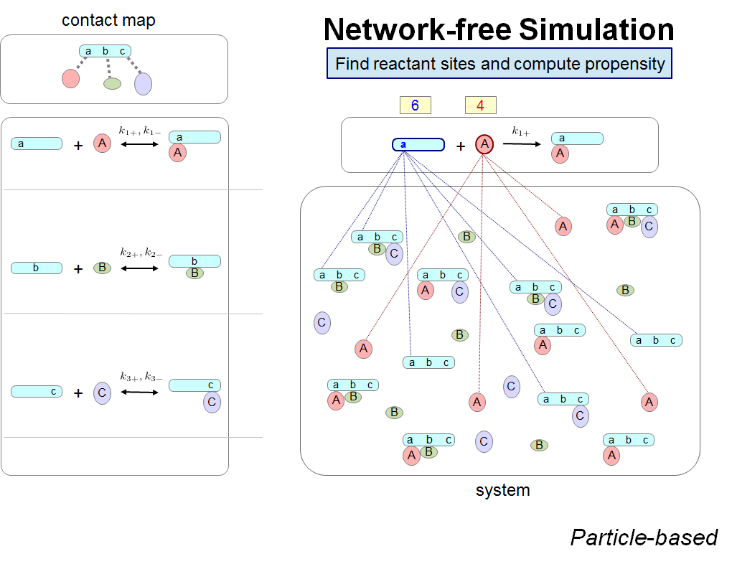
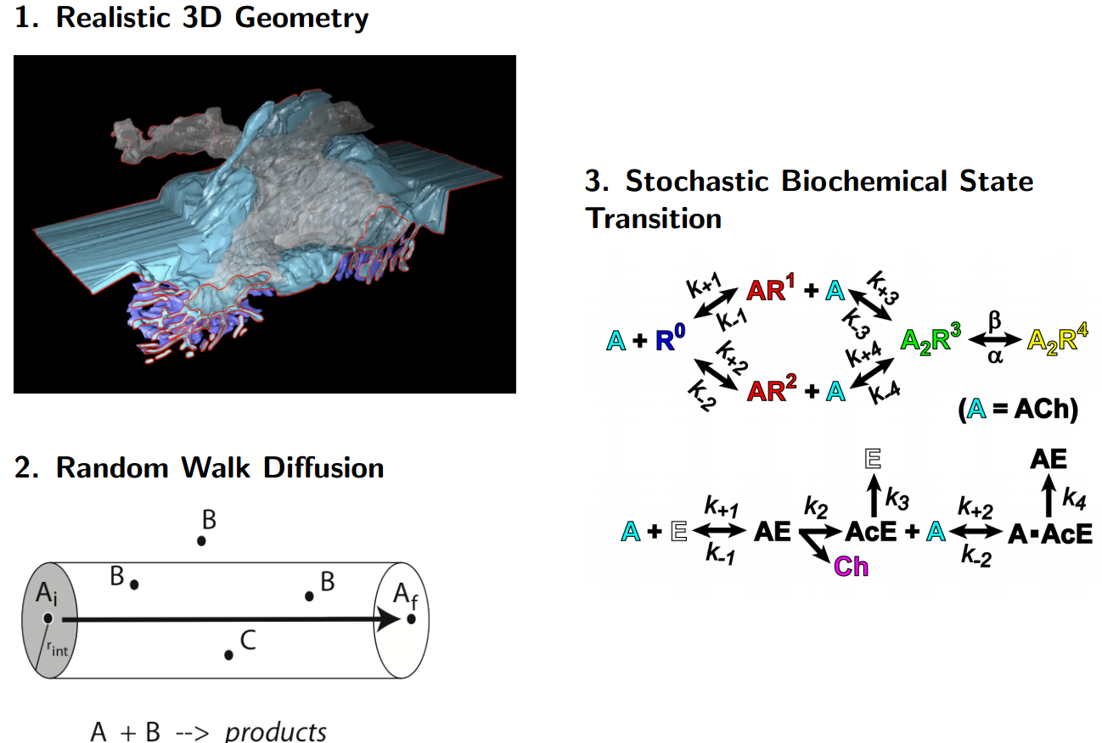

Development of network-free MCell
Beyond a well-mixed cell….
Jose Juan Tapia
MCell

Slide 38
Hands on portion

Slide 39
Lisman model for autoactivation
begin molecule types
K1(Y~0~P)
P(b)
end molecule types

Slide 40
Molecule Types
begin molecule types
K1(Y~0~P)
P(b)
end molecule types

Slide 41
Reaction Rules
begin reaction rules
R1: K1(Y~0) -> K1(Y~P) S
R1

Slide 42
Reaction Rules
begin reaction rules
R1: K1(Y~0) -> K1(Y~P) S
R2: K1(Y~0) + K1(Y~P) -> K1(Y~P) + K1(Y~P) 0.01
R2
R1

Slide 43
Reaction Rules
begin reaction rules
R1: K1(Y~0) -> K1(Y~P) S
R2: K1(Y~0) + K1(Y~P) -> K1(Y~P) + K1(Y~P) 0.01
R3: K1(Y~P) + P(b) <-> K1(Y~P!1).P(b!1) 0.4, 1
R4: K1(Y~P!1).P(b!1) -> K1(Y~0) + P(b) 1
end reaction rules
R2
R1
R4
R3

Slide 44
What we did so far
R2
R1
begin molecule types
K1(Y~0~P)
P(b)
end molecule types
Define molecules
R4
R3
begin reaction rules
R1: K1(Y~0) -> K1(Y~P) S
R2: K1(Y~0) + K1(Y~P) -> K1(Y~P) + K1(Y~P) 0.01
R3: K1(Y~P) + P(b) <-> K1(Y~P!1).P(b!1) 0.4, 1
R4: K1(Y~P!1).P(b!1) -> K1(Y~0) + P(b) 1
end reaction rules
Define rules

Slide 45
Parameters
Define parameters
begin parameters
S 0.01
end parameters
R2
R1
begin molecule types
K1(Y~0~P)
P(b)
end molecule types
Define molecules
R4
R3
begin reaction rules
R1: K1(Y~0) -> K1(Y~P) S
R2: K1(Y~0) + K1(Y~P) -> K1(Y~P) + K1(Y~P) 0.01
R3: K1(Y~P) + P(b) <-> K1(Y~P!1).P(b!1) 0.4, 1
R4: K1(Y~P!1).P(b!1) -> K1(Y~0) + P(b) 1
end reaction rules
Define rules

Slide 46
Species
Define parameters
begin parameters
S 0.01
end parameters
R2
R1
begin molecule types
K1(Y~0~P)
P(b)
end molecule types
Define molecules
R4
R3
Define initial conditions
begin species
K1(Y~0) 100
P(b) 10
end species
begin reaction rules
R1: K1(Y~0) -> K1(Y~P) S
R2: K1(Y~0) + K1(Y~P) -> K1(Y~P) + K1(Y~P) 0.01
R3: K1(Y~P) + P(b) <-> K1(Y~P!1).P(b!1) 0.4, 1
R4: K1(Y~P!1).P(b!1) -> K1(Y~0) + P(b) 1
end reaction rules
Define rules

Slide 47
Species
Define parameters
begin parameters
S 0.01
end parameters
R2
R1
begin molecule types
K1(Y~0~P)
P(b)
end molecule types
Define molecules
R4
R3
begin species
K1(Y~0) 100
P(b) 10
end species
Define initial conditions
begin reaction rules
R1: K1(Y~0) -> K1(Y~P) S
R2: K1(Y~0) + K1(Y~P) -> K1(Y~P) + K1(Y~P) 0.01
R3: K1(Y~P) + P(b) <-> K1(Y~P!1).P(b!1) 0.4, 1
R4: K1(Y~P!1).P(b!1) -> K1(Y~0) + P(b) 1
end reaction rules
Define rules

Slide 48
Obervables
Define parameters
begin parameters
S 0.01
end parameters
R2
R1
begin molecule types
K1(Y~0~P)
P(b)
end molecule types
Define molecules
R4
R3
begin species
K1(Y~0) 100
P(b) 10
end species
Define initial conditions
begin observables
Molecules K1p K1(Y~P)
end observables
Define observables
begin reaction rules
R1: K1(Y~0) -> K1(Y~P) S
R2: K1(Y~0) + K1(Y~P) -> K1(Y~P) + K1(Y~P) 0.01
R3: K1(Y~P) + P(b) <-> K1(Y~P!1).P(b!1) 0.4, 1
R4: K1(Y~P!1).P(b!1) -> K1(Y~0) + P(b) 1
end reaction rules
Define rules

Slide 49
Actions
begin model
Define parameters
begin parameters
S 0.01
end parameters
R2
R1
begin molecule types
K1(Y~0~P)
P(b)
end molecule types
Define molecules
R4
R3
begin seed species
K1(Y~0) 100
P(b) 10
end seed species
Define initial conditions
begin observables
Molecules K1p K1(Y~P)
end observables
Define observables
begin reaction rules
R1: K1(Y~0) -> K1(Y~P) S
R2: K1(Y~0) + K1(Y~P) -> K1(Y~P) + K1(Y~P) 0.01
R3: K1(Y~P) + P(b) <-> K1(Y~P!1).P(b!1) 0.4, 1
R4: K1(Y~P!1).P(b!1) -> K1(Y~0) + P(b) 1
end reaction rules
Define rules
end model
Define actions

Slide 50
Actions
begin model
Define parameters
begin parameters
S 0.01
end parameters
R2
R1
begin molecule types
K1(Y~0~P)
P(b)
end molecule types
Define molecules
R4
R3
begin seed species
K1(Y~0) 100
P(b) 10
end seed species
Define initial conditions
begin observables
Molecules K1p K1(Y~P)
end observables
Define observables
begin reaction rules
R1: K1(Y~0) -> K1(Y~P) S
R2: K1(Y~0) + K1(Y~P) -> K1(Y~P) + K1(Y~P) 0.01
R3: K1(Y~P) + P(b) <-> K1(Y~P!1).P(b!1) 0.4, 1
R4: K1(Y~P!1).P(b!1) -> K1(Y~0) + P(b) 1
end reaction rules
Define rules
end model
Define actions

Slide 51
Actions
begin model
Define parameters
begin parameters
S 0.01
end parameters
R2
R1
begin molecule types
K1(Y~0~P)
P(b)
end molecule types
Define molecules
R4
R3
begin seed species
K1(Y~0) 100
P(b) 10
end seed species
Define initial conditions
begin observables
Molecules K1p K1(Y~P)
end observables
Define observables
begin reaction rules
R1: K1(Y~0) -> K1(Y~P) S
R2: K1(Y~0) + K1(Y~P) -> K1(Y~P) + K1(Y~P) 0.01
R3: K1(Y~P) + P(b) <-> K1(Y~P!1).P(b!1) 0.4, 1
R4: K1(Y~P!1).P(b!1) -> K1(Y~0) + P(b) 1
end reaction rules
Define rules
end model
Define actions
generate_network()
simulate({method=>"ode", t_end=>100, n_steps=>200})

Slide 52
Complete file
begin model
Define parameters
begin parameters
S 0.01
end parameters
R2
R1
begin molecule types
K1(Y~0~P)
P(b)
end molecule types
Define molecules
R4
R3
begin seed species
K1(Y~0) 100
P(b) 10
end seed species
Define initial conditions
begin observables
Molecules K1p K1(Y~P)
end observables
Define observables
begin reaction rules
R1: K1(Y~0) -> K1(Y~P) S
R2: K1(Y~0) + K1(Y~P) -> K1(Y~P) + K1(Y~P) 0.01
R3: K1(Y~P) + P(b) <-> K1(Y~P!1).P(b!1) 0.4, 1
R4: K1(Y~P!1).P(b!1) -> K1(Y~0) + P(b) 1
end reaction rules
Define rules
end model
Define actions
generate_network()
simulate({method=>"ode", t_end=>100, n_steps=>200})

Slide 53
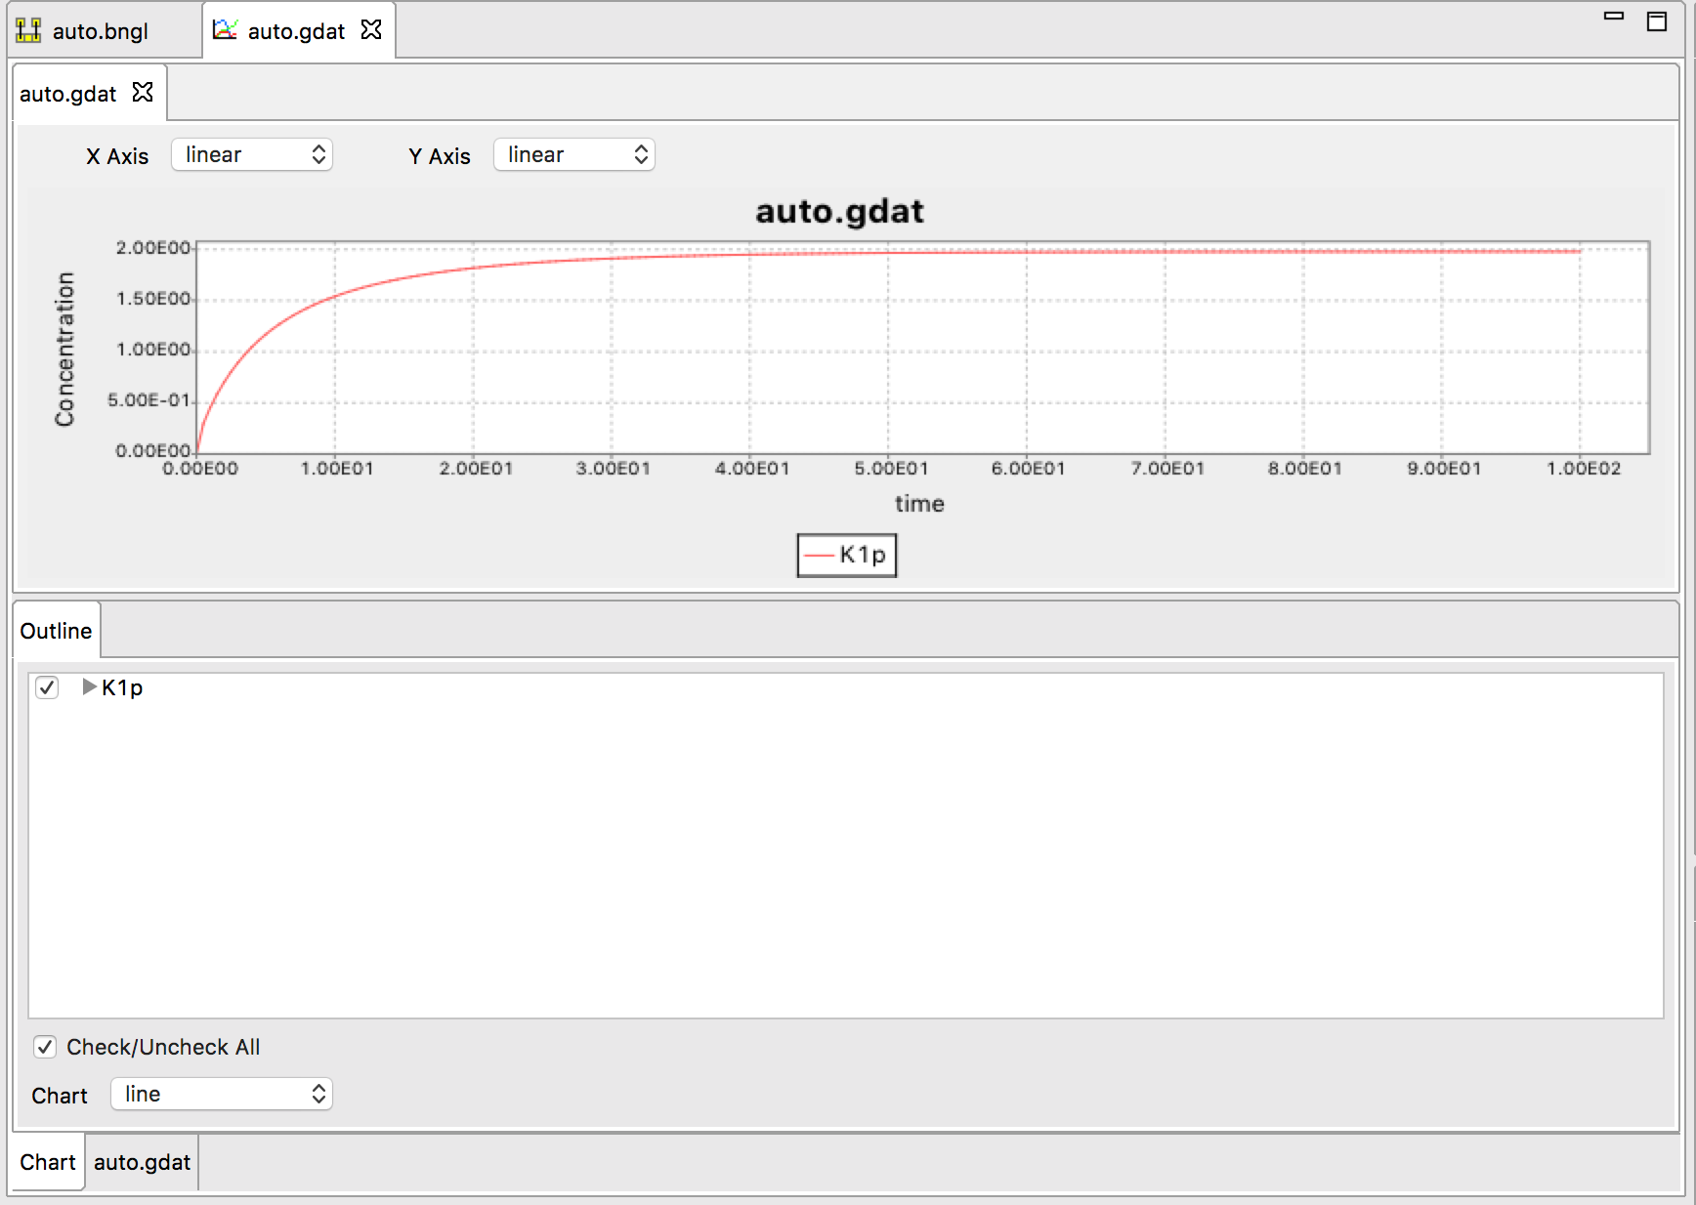
Simulation Output
RuleBender View
begin model
begin parameters
S 0.01
end parameters
R2
R1
begin molecule types
K1(Y~0~P)
P(b)
end molecule types
R4
R3
begin seed species
K1(Y~0) 100
P(b) 10
end seed species
begin observables
Molecules K1p K1(Y~P)
end observables
begin reaction rules
R1: K1(Y~0) -> K1(Y~P) S
R2: K1(Y~0) + K1(Y~P) -> K1(Y~P) + K1(Y~P) 0.01
R3: K1(Y~P) + P(b) <-> K1(Y~P!1).P(b!1) 0.4, 1
R4: K1(Y~P!1).P(b!1) -> K1(Y~0) + P(b) 1
end reaction rules
end model
generate_network()
simulate({method=>"ode", t_end=>100, n_steps=>200})

Slide 54
Parameter Scan
Use parameter_scan action in the BNGL file
parameter_scan({parameter=>"S",par_min=>1e-3,par_max=>1e-1,n_scan_pts=>50,\
method=>"ode",t_end=>10000,log_scale=>1})

Slide 55
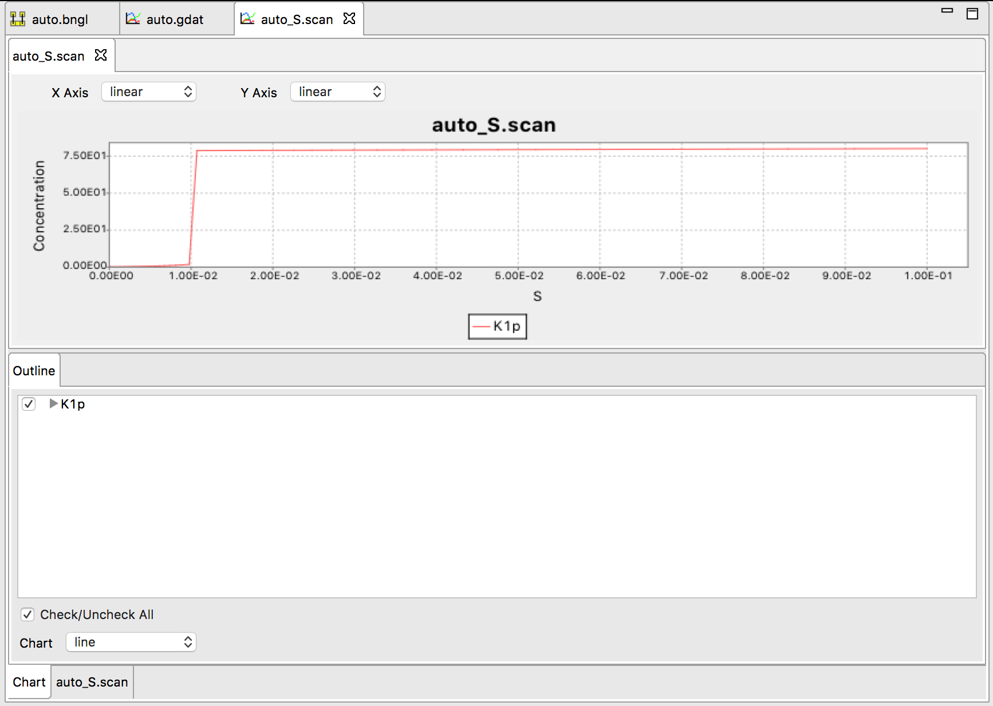
Understanding the observed switching behavior
Below the switching point, this system has two stable steady states.

Slide 56
Understanding the observed switching behavior
Below the switching point, this system has two stable steady states.
This can be shown by making a rate balance plot:

Slide 57

Understanding the observed switching behavior
Below the switching point, this system has two stable steady states.
This can be shown by making a rate balance plot:
https://www.molbiolcell.org/doi/10.1091/mbc.E20-08-0530

Slide 58
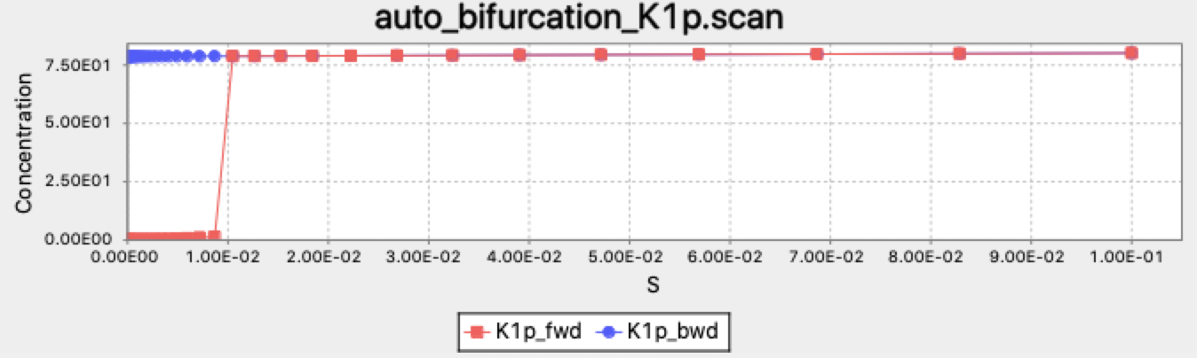
Bistability can be identified using the bifurcate action, which uses a bidirectional scan
bifurcate({parameter=>"S",par_min=>1e-5,par_max=>1e-1,n_scan_pts=>50,\
method=>"ode",t_end=>10000,log_scale=>1})
Starting point for each simulation at new parameter value along scan is end point from previous simulation.

Slide 59
Bistability can be identified using the bifurcate action, which uses a bidirectional scan
bifurcate({parameter=>"S",par_min=>1e-5,par_max=>1e-1,n_scan_pts=>50,\
method=>"ode",t_end=>10000,log_scale=>1})
Starting point for each simulation at new parameter value along scan is end point from previous simulation.
Bistable region
Note that with these parameters, the switch is irreversible

Slide 60
Stochastic effects in bistable systems
Exercise:
Run a long ssa simulation of the auto model and describe what you observe.

Slide 61
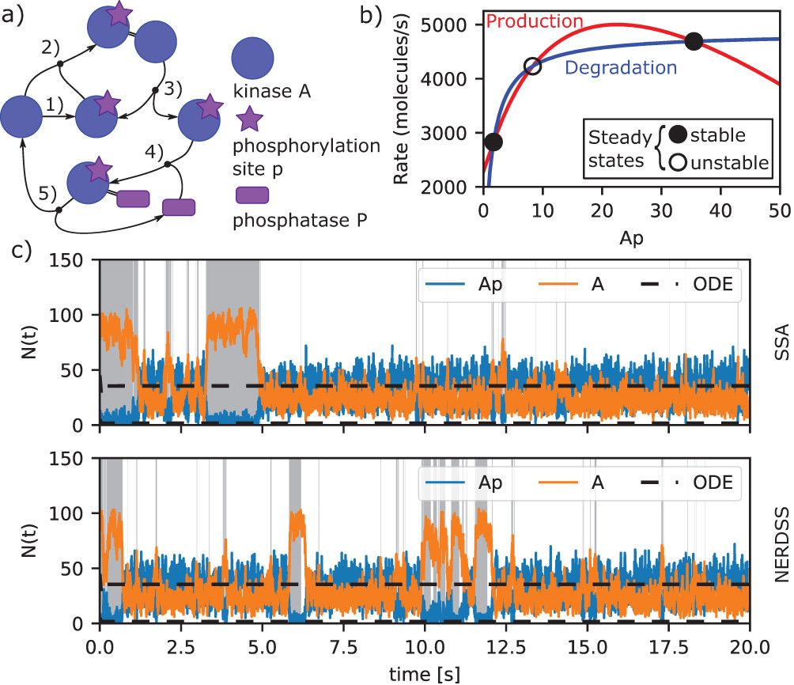
Stochastic effects in bistable systems
Exercise:
Run a long ssa simulation of the auto model and describe what you observe.
Result:
https://www.molbiolcell.org/doi/10.1091/mbc.E20-08-0530

